Slide 1





https://ai4mi.epotentia.com
Hands-on session 1
Steel defect classification with machine learning

Slide 2




Slide 3

What is AI?
Series of techniques to extract information from data

Slide 4
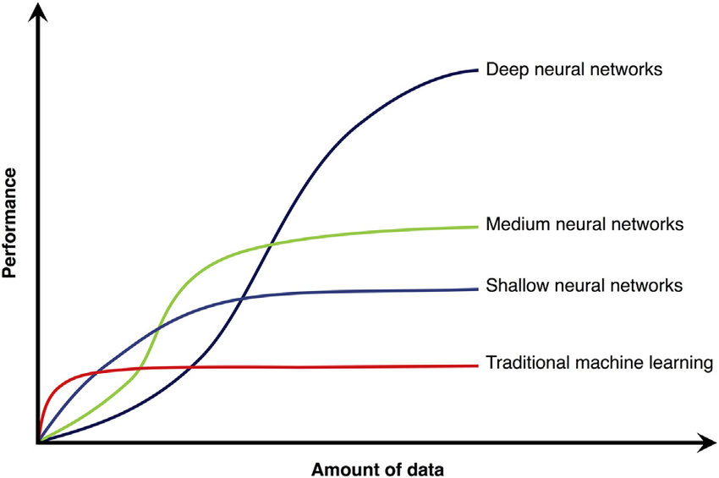
Types of AI
Deep learning
GPU
Performance
Machine learning
Statistics
CPU
Amount of information
The more data we have, the more we trade insight for predictive power

Slide 5
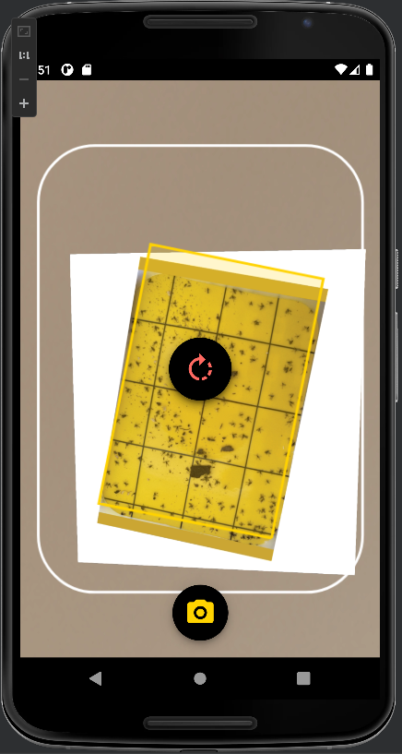
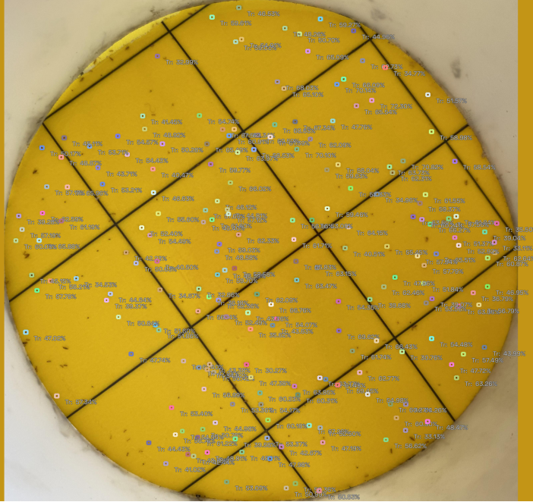
Example application: BioBest

Slide 6


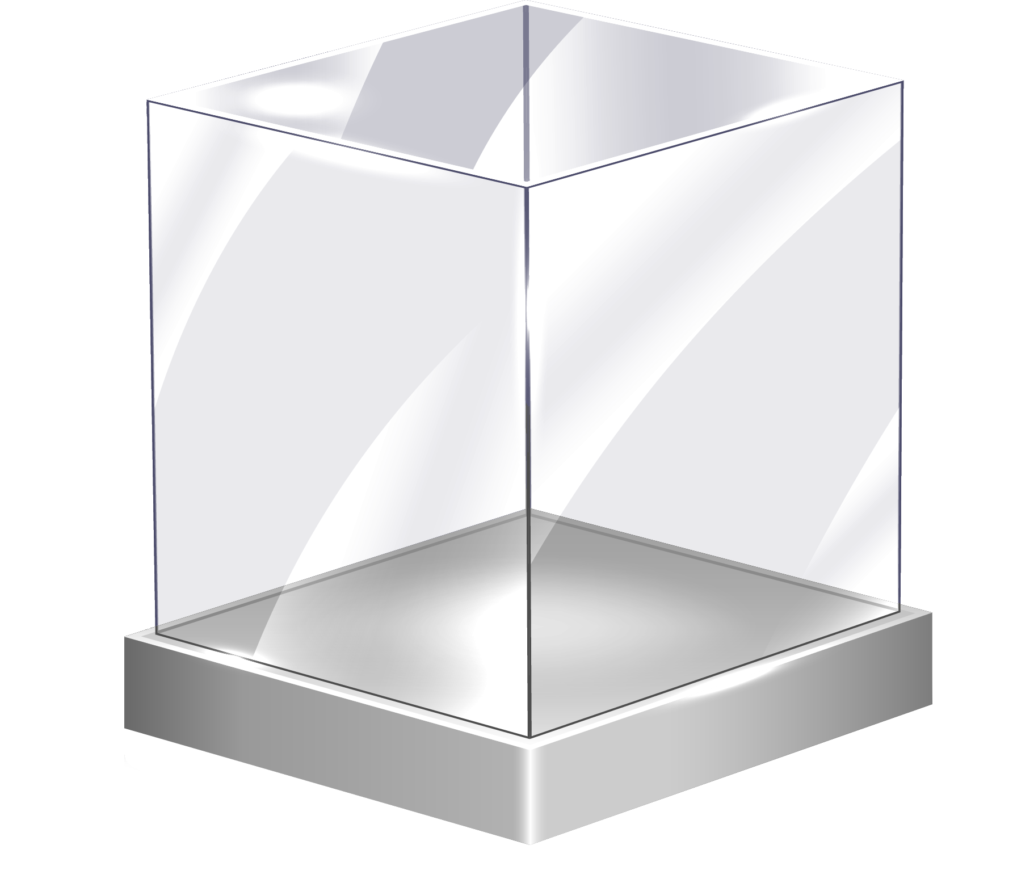

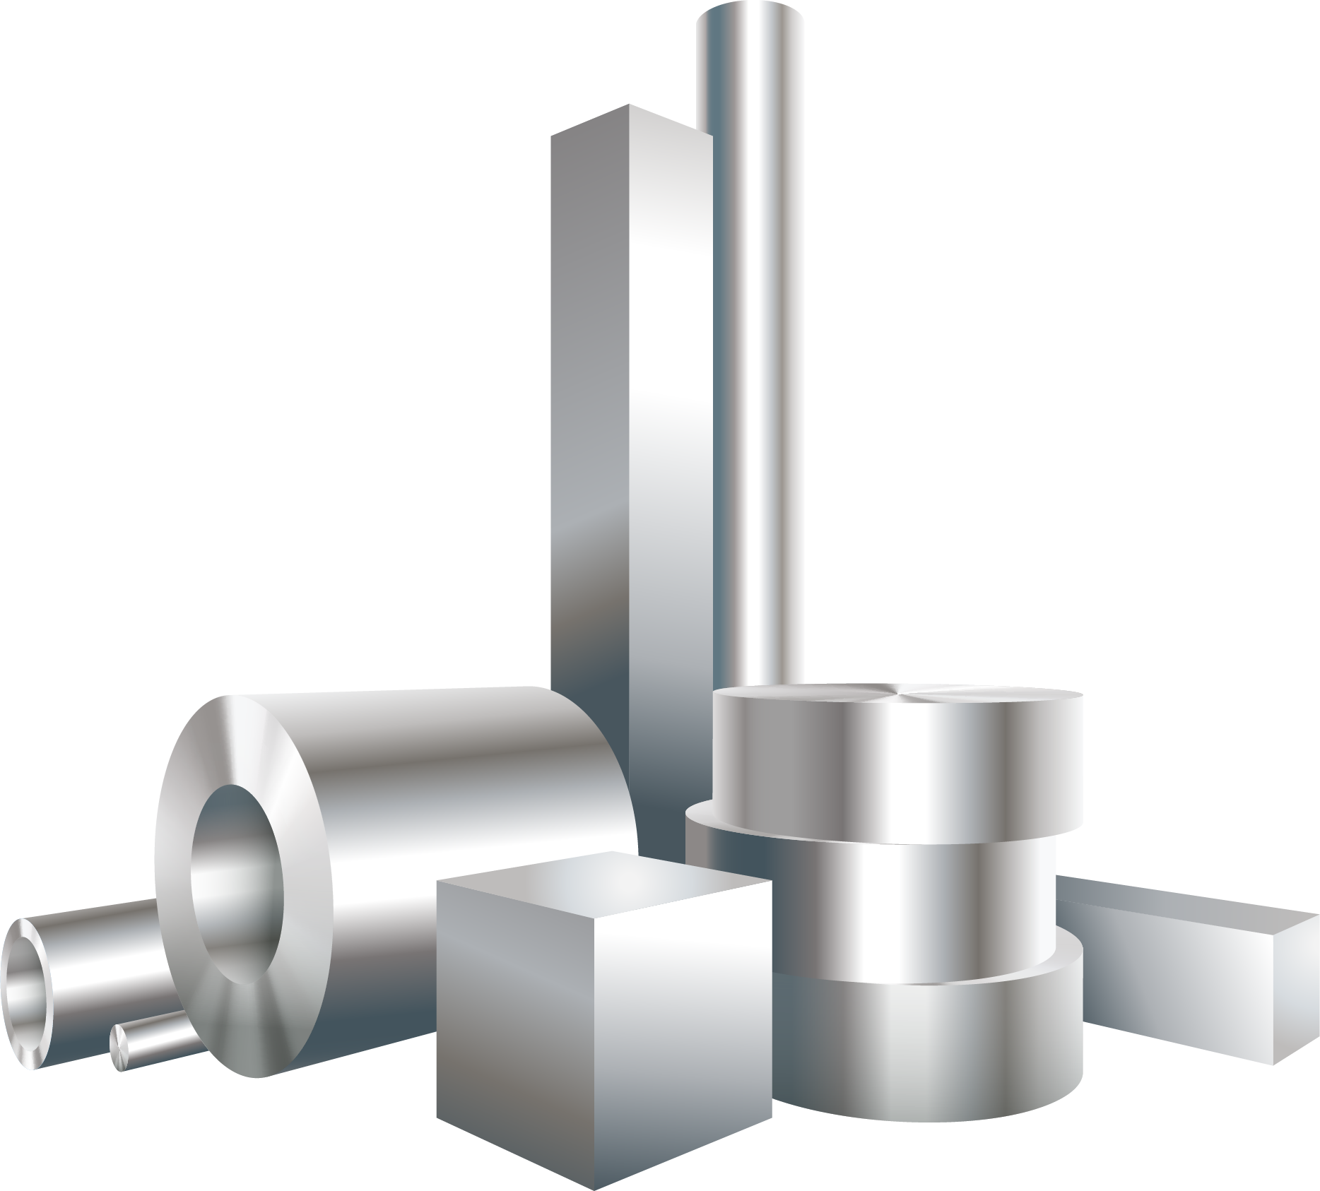



Case studies
Glass
Spreadsheet data
Steel
Materials discovery
Manufacturing
Computer vision
Sensor data

Slide 7
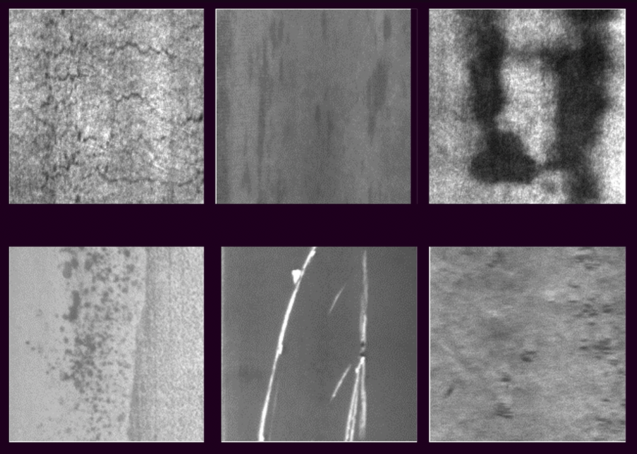
Steel plate defects
Crazing
Inclusions
Patches
Rolled-in scale
Scratches
Pits

Slide 8
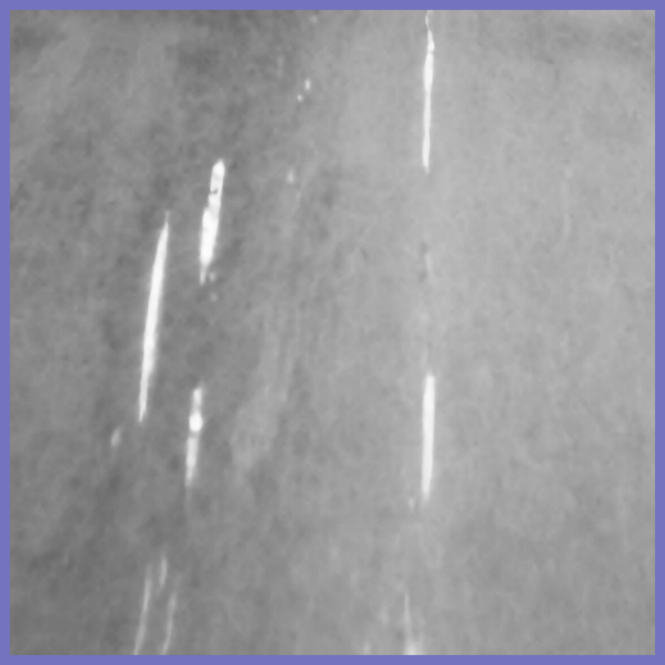
Multi-step pipeline
Detector
Featurizer
Classifier
Part of the pipeline needs to run in production

Slide 9
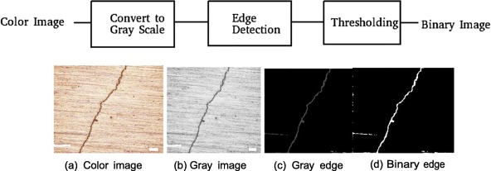
Detector
Original
Grayscale
Threshold
Source: https://doi.org/10.1016/j.aej.2019.10.001
Simple and effective, but can be fickle

Slide 10
Featurizer
Size and shape
Brightness and contrast
Materials properties
Processing information
Features are numerical representation of the data created using our knowledge

Slide 11
This session
Analyze the features
(optional) Add more
Choose a model
Optimize the model
Evaluate the results
Interpret with explainable AI
Part of the pipeline needs to run in production

Slide 12
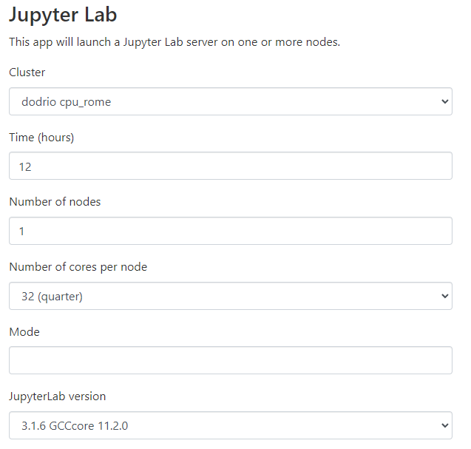
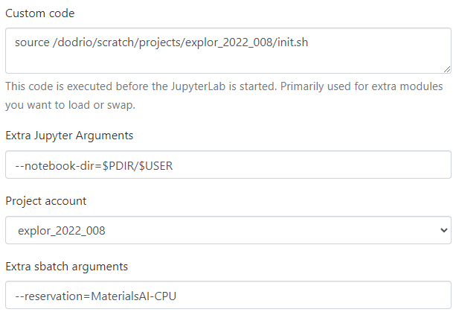
Requesting a job
Log in at https://tier1.hpc.ugent.be

Slide 13




Dataset
What is the dataset?
Where did it come from?
Who made it?
What are the inputs?
What are the outputs?

Slide 14
Tabular data
Feature
Datapoint
Value

Slide 15


Python Pandas
|
pip install pandas

Slide 16
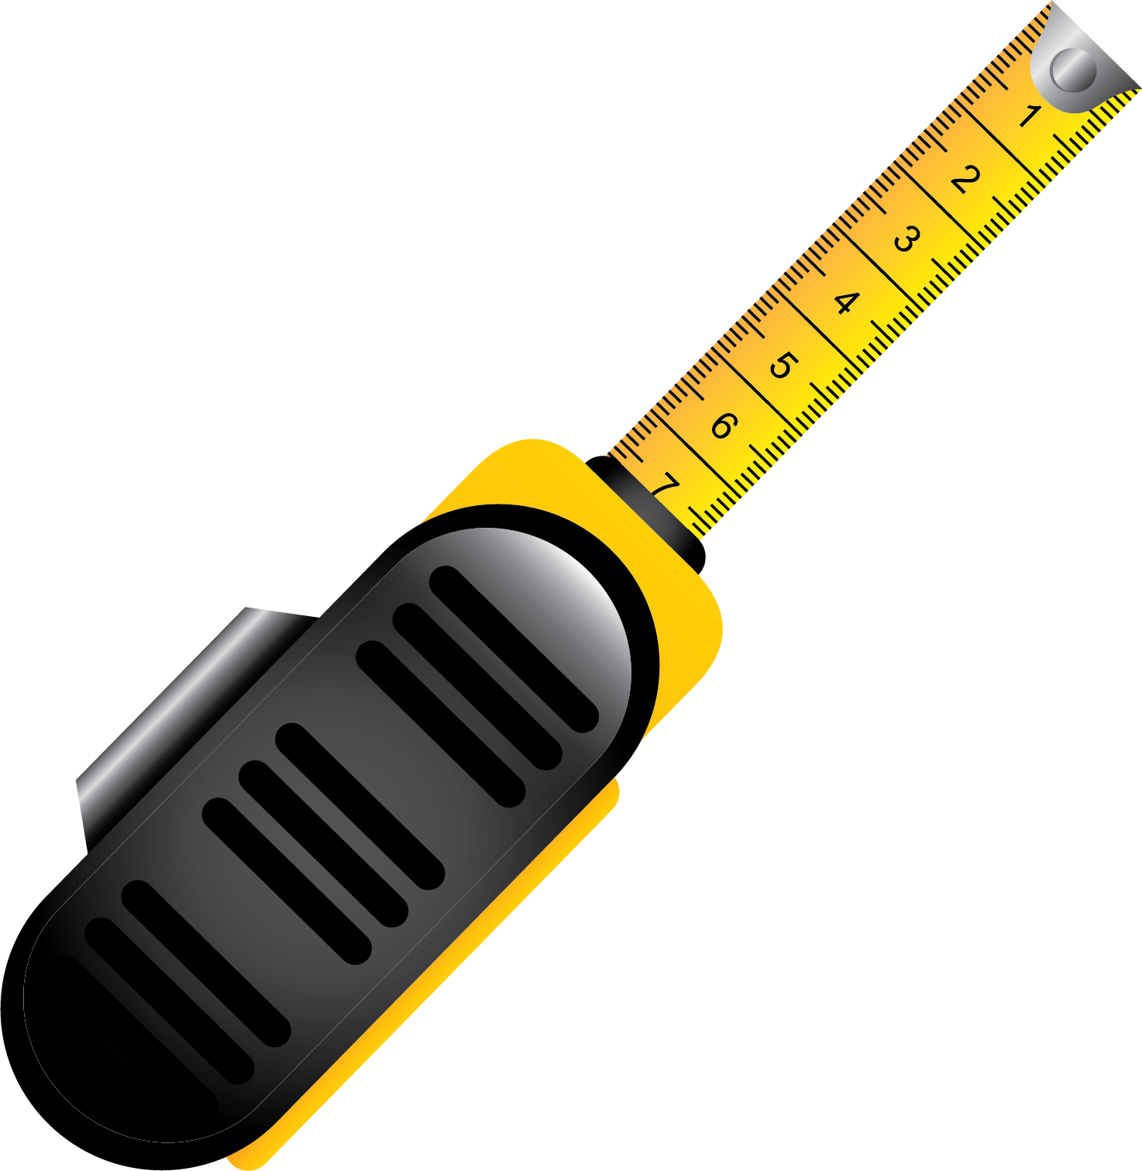

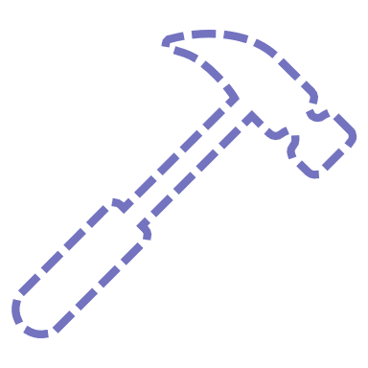

Exploratory Data Analysis
What kind of features are in the dataset?
What is the range of the values?
What do the features represent?
Are they independent?
Is there missing data?
Are certain outputs rare or abundant?

Slide 17
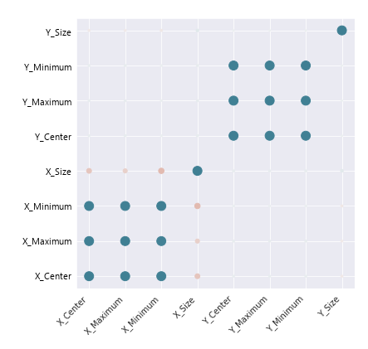
Example: feature independence
Strongly correlated features are opportunities for optimization

Slide 18
Machine learning ingredients
Target function
Input data
Target
We must find the function that connects the inputs to the target

Slide 19
Machine learning ingredients
ML approximation
Data
Target
Learning algorithm
Hypothesis
set

Slide 20
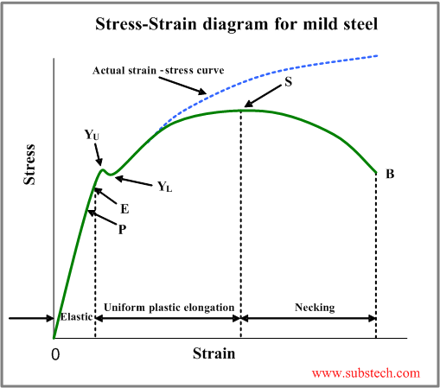
Example: tensile curve
Type of representation can greatly affect the performance

Slide 21
Constructing a dataset
Diverse dataset
Materials
Etchings
Machines
People
Collecting a good dataset takes time

Slide 22
Generalization
Diverse data
Training
Validation
Test
Be very careful for data leakage

Slide 23
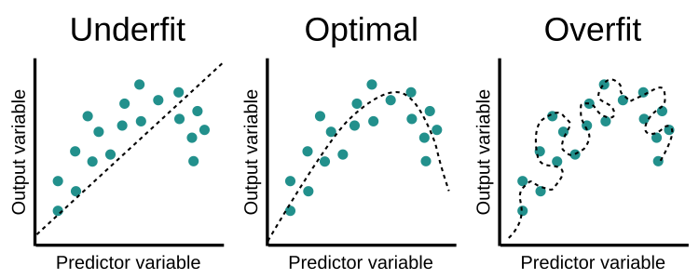
Fitting your model
Choose a model of the right complexity and regularize where needed

Slide 24
Generalization
Underfitting
Overfitting
Validation error
Error
Training error
Complexity
Regularization techniques can prevent overfitting

Slide 25
Decision trees
Weather?
Rain
Sun
Take the bus
Time?
< 30 min
> 30 min
Take the bus
Walk to work
Robust, flexible in amount of data, controllable speed (CPU)

Slide 26
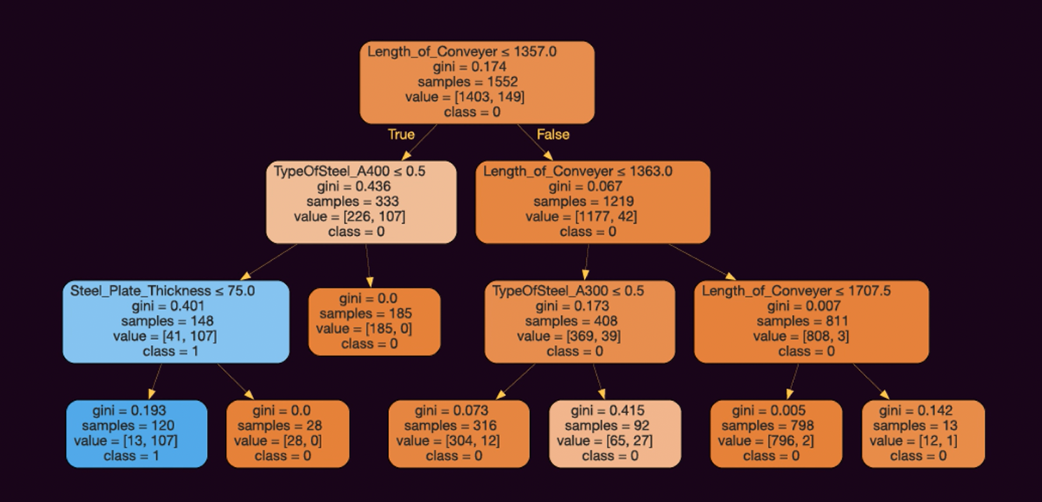
Bump decision tree
A single tree greatly risks overfitting

Slide 27

Random forests
By taking many simple trees, we average out the error and prevent overfitting

Slide 28
Out-of-bag score
N samples are chosen for each tree with repetition (bagging)
Tree 1
Tree 2
Tree 3
36,2% of the data is unseen by each tree which can be used for OOB validation

Slide 29
Hyperparameters
Number of trees n_estimators
Depth of the trees max_depth
Amount of data per tree max_samples
Number of features per tree max_features
Samples per split min_samples_split
Samples per leaf min_samples_split
Perfect for high-throughput screening

Slide 30
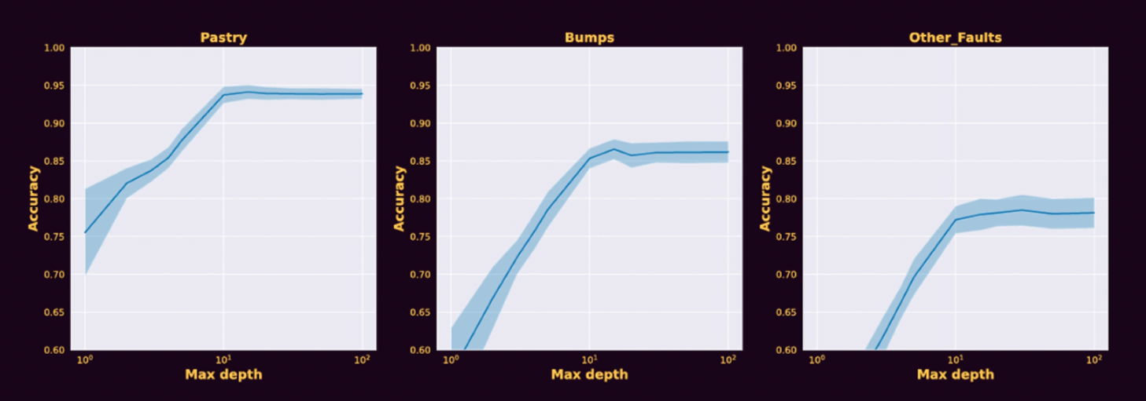
Example: tree depth
Deeper trees are better, but slower and risk overfitting

Slide 31
Accuracy
Decision trees can split the dataset down to individual samples
100% accuracy on training is easy, almost trivial
This doesn’t mean good performance “in the wild”, the model might have just learned to recognize distinct noise patterns that don’t generalize
This is why we need a validation and test set: a fair assessment

Slide 32
Metrics
Accuracy: How often did we get it right? Gives no information about what type of mistakes are being made
Confusion matrix: Very useful tool to understand what’s going on, showing true positive (TP), false positive (FP), false negative (FN) and true negative (TN)
 |  | Real data
 |  | + | -
Predicted data | + | TP | FP
 | - | FN | TN

Slide 33
Metrics
 |  | Real data
 |  | + | -
Predicted data | + | TP | FP
 | - | FN | TN
Accuracy: How often did we get it right? (TP and TN)
Precision: Quality, how many of the positive samples are real? (FP)
Recall: Quantity, How many of the positive samples did we find? (FN)
Choosing the right metric for your goal is important

Slide 34
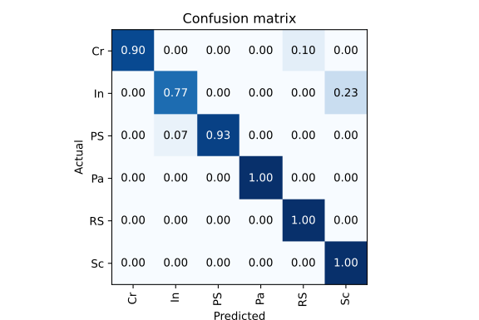
Metrics
The confusion matrix is more general than just true/false, can give insight in whether certain classes get confused for each other
Other metrics exist beyond accuracy, precision, recall.
F1-score: geometric mean between precision and recall, good middle ground
Matthews Correlation Coefficient (MCC): Cross-correlation between the real data and predicted data, ranges from -1 (anticorrelated) to +1 (correlated)

Slide 35
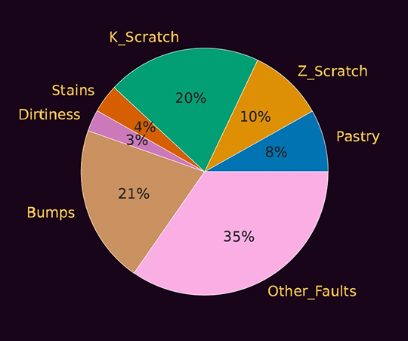
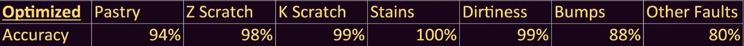
Results
Choosing the right metric for an application is important

Slide 36
Explainable AI
The model uses features to make predictions
How important is a feature? Remove it and find out!
Drop-column feature importance:
Remove feature
Retrain model
Compare
Permutation feature importance:
Shuffle feature
Make prediction with same model
Compare

Slide 37
Explainable AI
No features
10%
Type of steel
40%
Defect size
30%
Brightness
20%
Type, size
50%
Type, brightness
45%
Size, brightness
80%

Slide 38
Explainable AI
No features
10%
+30%
Type of steel
40%
Defect size
30%
Brightness
20%
+20%
+25%
Type, size
50%
Type, brightness
45%
Size, brightness
80%
If we could simulate all possible models we could evaluate the impact -> SHAP
The SHAP value is the average contribution of the feature

Slide 39
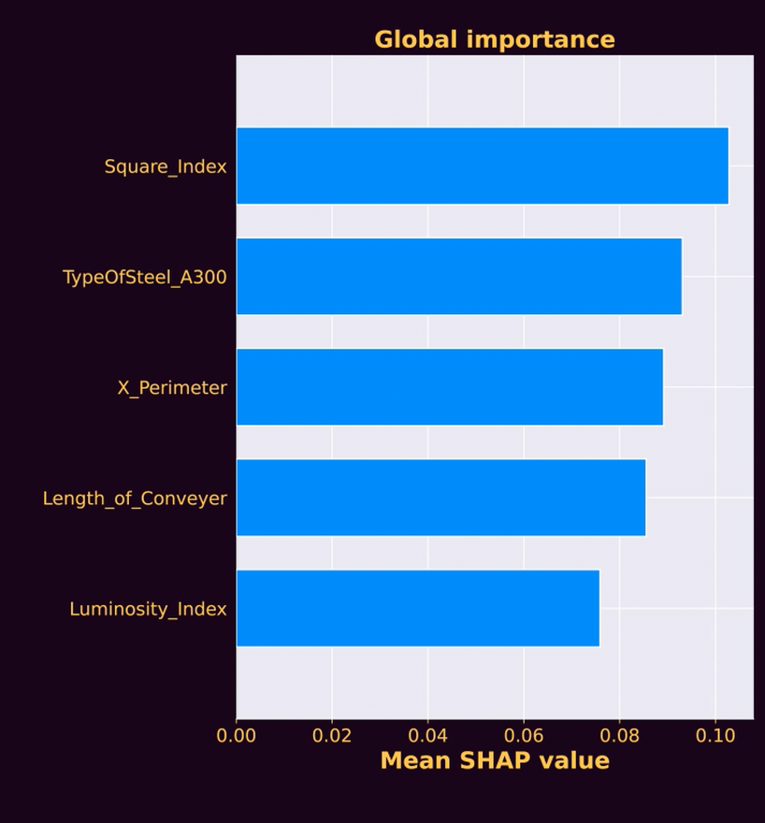
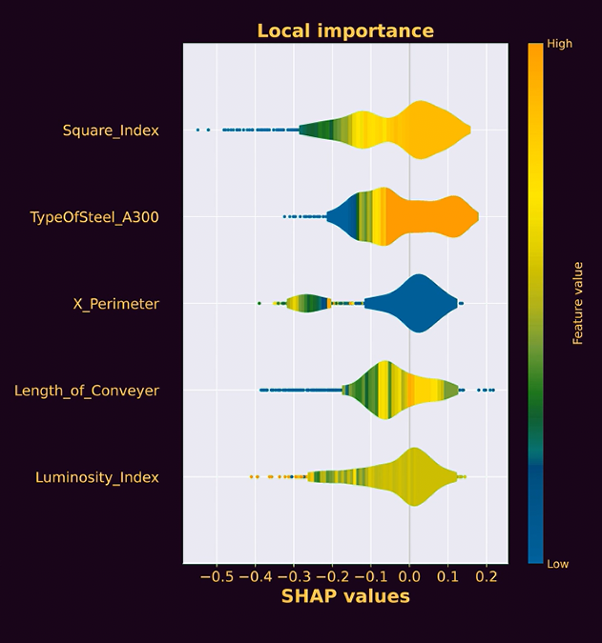
Practical SHAP for bumps
https://github.com/slundberg/shap
SHAP helps us understand how a decision is reached

Slide 40





View more online
https://ai4mi.epotentia.com
Glass
Manufacturing
Materials discovery
Sensor data
Sensor data

